Slide 1
The effects of freezing time on microbial growth on beef and Calculation of freezing time estimation on beef using Plank’s Equation
Vinay Madala, Melody Jackson, & Ostavia Cintron.
Food Engineering and Food Microbiology
November 20, 2020

Slide 2
Outline

Slide 3
Background on Beef

Slide 4
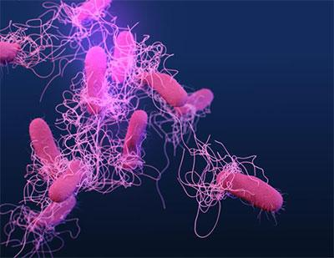
Salmonella spp.
Lives within the gastrointestinal tract of cattle
Bacterium associated with foodborne illness
Requires an amount of 10⁵ CFU
Symptoms occurs after 24 to 48 hours
  Pain within the midsection
  Diarrhea
  Fever
  Vomiting
Miya et al (2014)
Center for Disease Control (2020b).

Slide 5
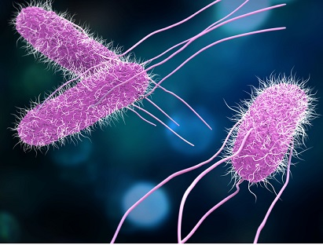
Salmonella spp.
Points of contamination:
  Feces
  Factories
  Water and Soil
Attaches itself to the equipment and utensils
2, 300 family “members” (serotypes)
Two types are associated with beef spoilage
  Salmonella typhimurium
  Salmonella enteritidis
Bhattacharjee et al (2011); Coutinho de Oliveira, de Araújo Soares, & Hilsdorf Piccoli, (2013).
Center for Disease control (2020c)

Slide 6
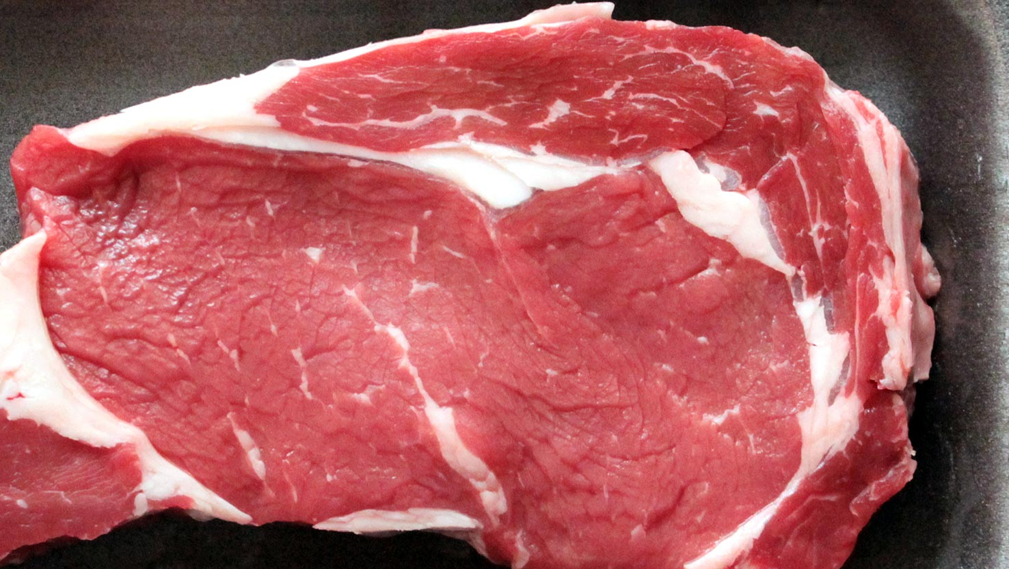
Salmonella spp.
Salmonella spp has been associated beef
  Salmonella typhimurium
  Salmonella enteritidis
Outbreaks
  Ground beef is the most common among outbreaks
  Lymph containing Salmonella are blended into ground beef
Laufer et al (2015); Koohmaraie et al (2012)
Alabama Department of Agriculture & Industries (2020)

Slide 7
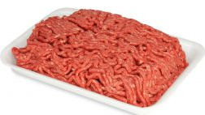
Salmonella spp.
Other examples of Salmonella spp serovars associated with beef:
Typhimurium serovar
Anatum serovar
Montevideo serovar
Muenchen serovar
Ferrari et al (2019).
Center for Disease Control (2020a)

Slide 8
Salmonella spp.

Slide 9
Salmonella spp.

Slide 10
Listeria monocytogenes

Slide 16
E. Coli

Slide 21
Freezing time:-
The freezing time is the time taken to lower the temperature of the product (beef) from its initial temperature to a given temperature at its thermal center.
Foods, undergoing freezing is a complex process, release latent heat over a range of temperature (Freezing does not occur at a unique temperature, foods do not have constant thermal properties during freezing).

Slide 22
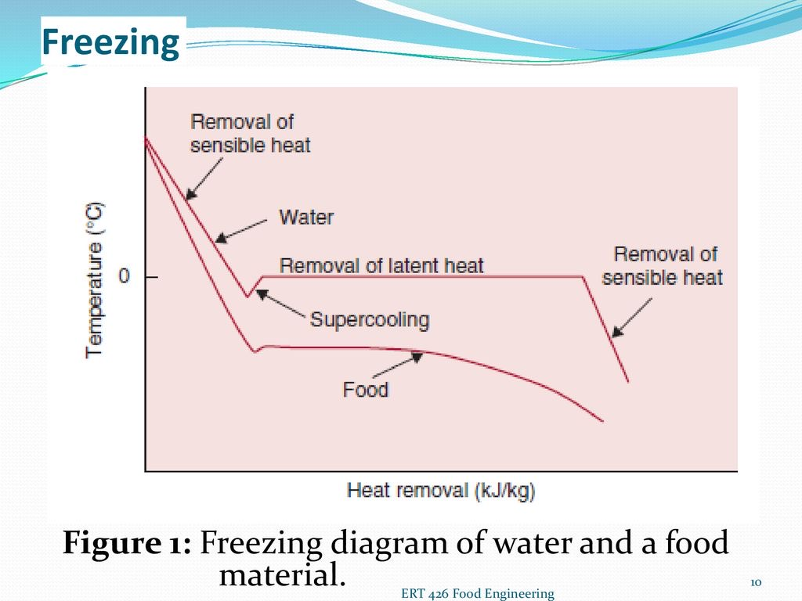
Freezing time:-
There are three stages in freezing process.
Pre-cooling:- Removal of sensible heat to lower the temperature of food to freezing point.
Phase transfer point change:- Removal of latent heat of fusion leading to change of state and the formation of ice crystals.
Tempering period:- After the formation of ice further sensible heat removal down to required storage temperature.

Slide 23
Calculation of freezing time:-
Significance:-
Quality
Processing requirements
Economical aspects of food freezing
Freezing time estimation depends on below factors
Temperature
Shape of product
Thickness of the product
Initial and final temperatures of the product
Heat transfer process

Slide 24
Freezing time:-
Food properties to be considered
Thermal conductivity
Thermal diffusivity
Enthalpy
Specific heat
Density

Slide 25
Plank’s equation:-
The first and most popular equation for predicting freezing time.
One dimensional heat transfer
Initial temperature of food is (TF) uniform
Three layers
Freezing air temperature is constant (Ta, - 40ºC)
Latent heat removal is constant temperature (Tf)

Slide 26
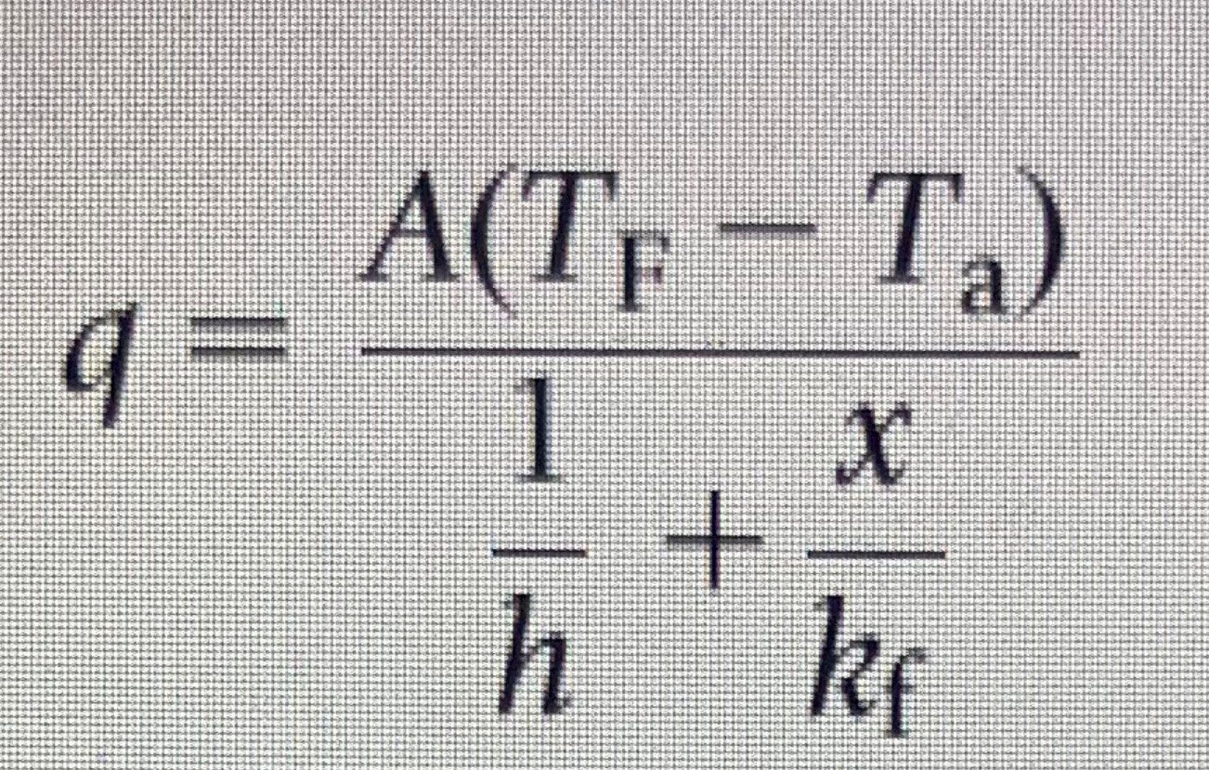
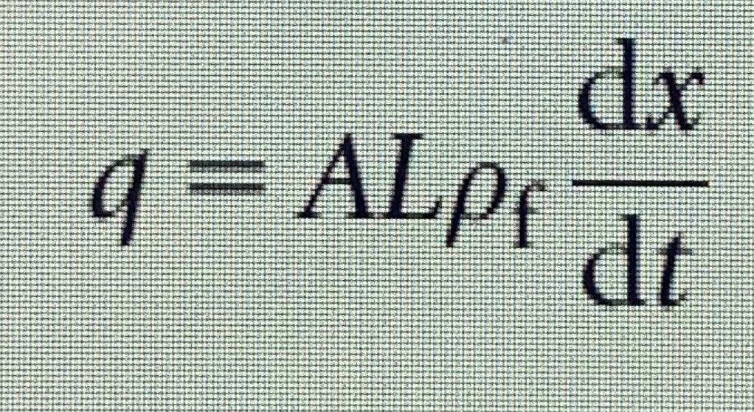
Plank’s equation:-
Latent heat of fusion L (consider)
The convective heat transfer coefficient at the surface of the slab is h.
Consider the rate of heat transfer(q)
The moving front advances with a velocity of dx/dt, L is generated
---------- 1
---------- 2

Slide 27
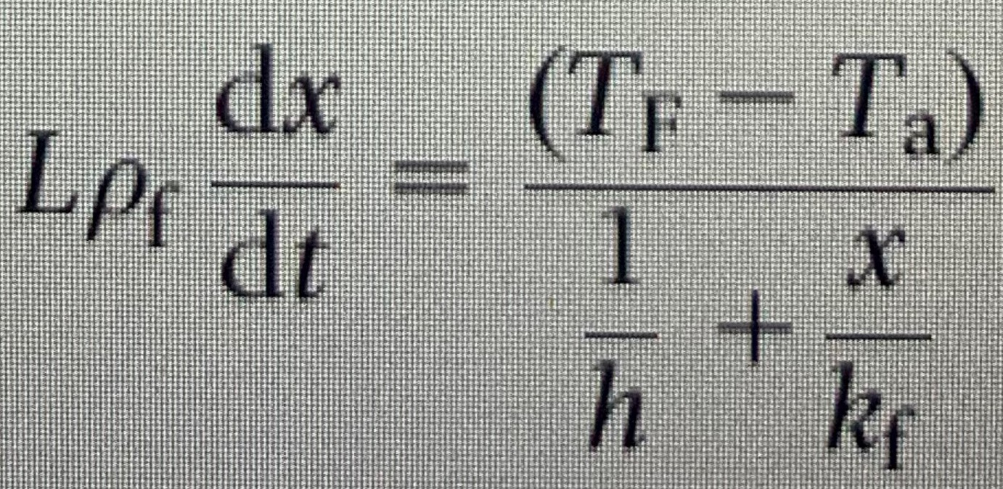
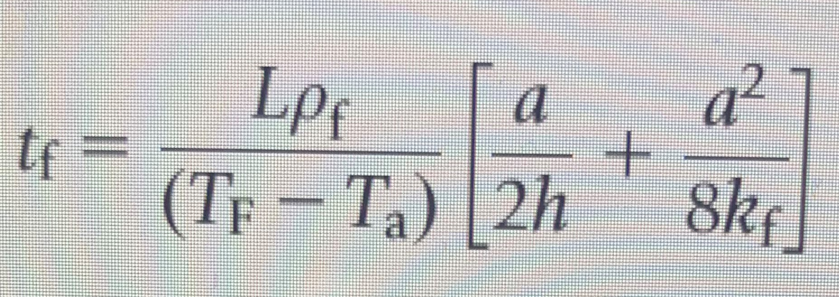
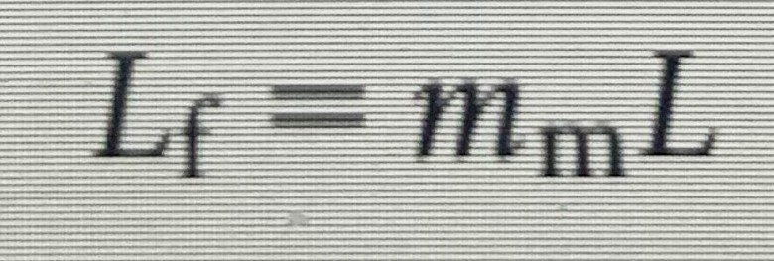
Plank’s equation:-
Equating the equations 1 and 2
------ 3
Integrating the equation---- 3
----- 4
To apply equation 4 to a food material with a moisture content m_{m},
---- 5
L is the latent heat of fusion of water, 333.3 kj/kg

Slide 28
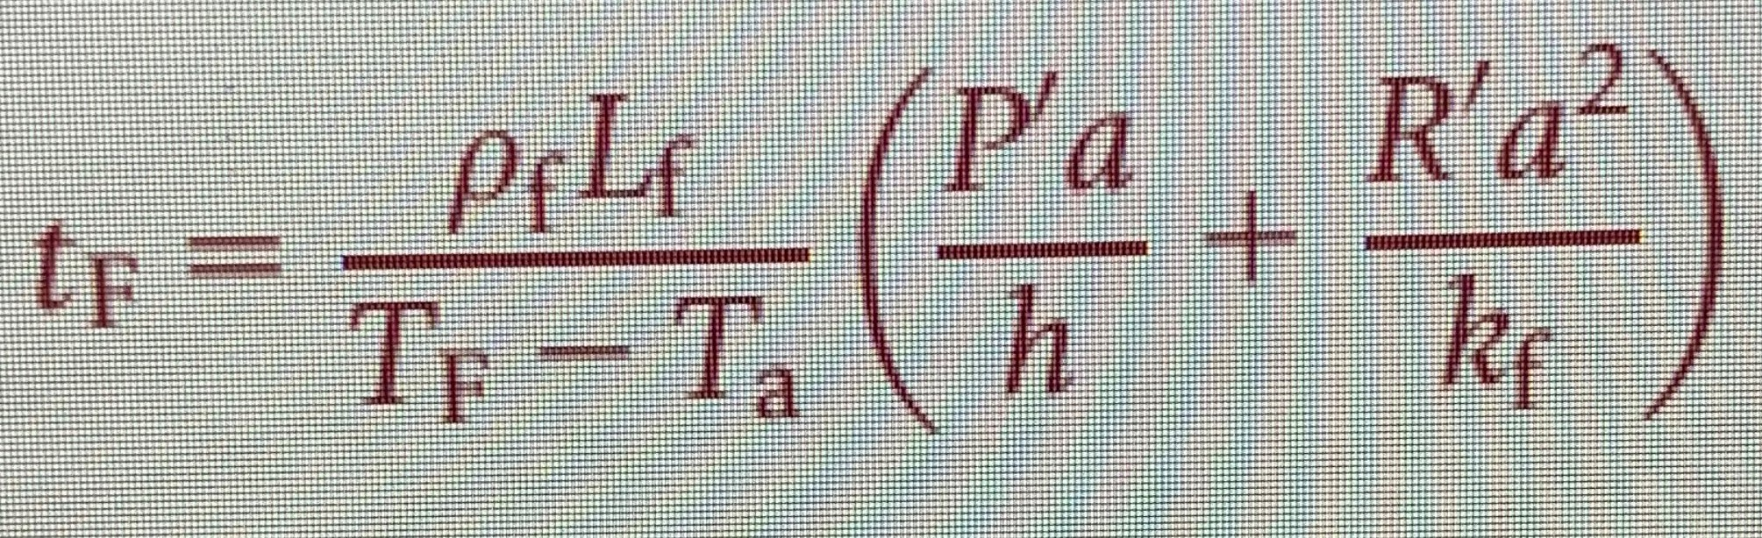
Plank’s equation:-
The plank’s equation is --------
𝛒f = Density of the food
Lf = change in latent heat of food
Tf= Freezing temperature
Ta= Freezing air temperature
h= convective heat transfer
a= thickness of the product(objective)
k= thermal conductivity of the frozen material
P¹ and R¹ are constant
P¹ = ¼, R¹ = ⅛ for infinite plate
P¹ = ¼, R¹ = 1/16 for infinite cylinder
P¹ = ⅙, R¹ = 1/16 for sphere

Slide 31
Reference
Bhattacharjee, P., Panigrahi, S., Lin, D., Logue, M. C., Sherwood, S., J., Doetkott, C., & Marchello, M. (2011). A comparative qualitative study of the profile of volatile organic compounds associated with Salmonella contamination of packaged aged and fresh beef by HS-SPME/GC-MS.
Journal of Food Science Technology, 48, 1–13 https://doi-org.aamu.idm.oclc.org/10.1007/s13197-010-0138-6
Coutinho de Oliveira, L., T., de Araújo Soares, R., & Hilsdorf Piccoli, R. (2013).
A Weibull model to describe antimicrobial kinetics of oregano and lemongrass essential oils against Salmonella Enteritidis in ground beef during refrigerated storage,
Meat Science, 93 (3), 645-651,
https://doi.org/10.1016/j.meatsci.2012.11.004.
Ferrari, R. G., Rosario, D., Cunha-Neto, A., Mano, S. B., Figueiredo, E., & Conte-Junior, C. A. (2019). Worldwide Epidemiology of Salmonella Serovars in Animal-Based Foods: a Meta-analysis.
Applied and environmental microbiology, 85(14), e00591-19. https://doi.org/10.1128/AEM.00591-19

Slide 32
Reference
Laufer, A. S., Grass, J., Holt, K., Whichard, J. M., Griffin, P. M., & Gould, L. H. (2015). Outbreaks of Salmonella infections attributed to beef --United States, 1973-2011. Epidemiology and infection, 143(9), 2003–2013. https://doi.org/10.1017/S0950268814003112
Koohmaraie, M., Scanga,A., J., De La Zerda, J., M., Koohmaraie,B., Tapay, L., Beskhlebnaya, V., Mai, T., Greeson, K., Samadpour, M.(2012) Tracking the Sources of Salmonella in Ground Beef Produced from Nonfed Cattle. Journal of Food Protection 75 (8): 1464–1468. doi: https://doi-org.aamu.idm.oclc.org/10.4315/0362-028X.JFP-11-540
Miya, S., Takahashi, H., Hashimoto, M., Nakazawa, M., Kuda, T., Koiso, H., & Kimura, B. (2014). Development of a controlling method for Escherichia coli O157:H7 and Salmonella spp. in fresh market beef by using polylysine and modified atmosphere packaging.
Food Control, 37, 62-67, https://doi.org/10.1016/j.foodcont.2013.09.028.

Slide 33
References (pictures)
Alabama Department of Agriculture & Industries (2020)
Retrieved from http://agi.alabama.gov/divisions/food-safety/fs-product-recalls/2020/06/15/lakeside-ref rigerated-services-recalls-beef-products-due-to-possible-e.coli-o157-h7-contamination
Center for Disease Control (2020a). Image of a package of ground beef.
Retrieved from https://www.cdc.gov/salmonella/newport-10-18/index.html
Center for Disease Control (2020b.) Image of a group of Salmonella Bacterium.
Retrieved from https://www.cdc.gov/salmonella/general/diagnosis-treatment.html
Center for Disease Control (2020c). Image of three Salmonella Bacterium.
Retrieved from https://www.fda.gov/food/foodborne-pathogens/salmonella-salmonellosis

